Slide 1

The Petroleum Industry
Spindletop Legal & Commercial
An insider’s perspective
Sean Rush –
March 2015

Slide 2
Overview
Who am I?
The Phases of Exploration & Production
Case Studies – UK and Newfoundland & Labrador
Risks
How do 21st Century Oil Companies think?
Opportunities for Ngati Kahungunu

Slide 3
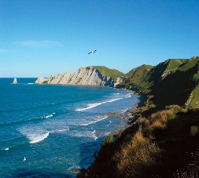

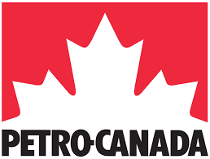


About – Sean Rush
Born/Bred Taradale, St John’s College Hastings 1982 - 1986
Victoria University 1987 – 1991 LLB
Napier general practice lawyer, McKay Hill & Co, 1992 – 94
1996 - 2013
Eni - Legal Adviser
  UK
Petro-Canada - Head of Legal North West Europe
  Canada & North West Europe –UK, Norway, The Netherlands, Russia
Memery Crystal LLP – Partner
  London, Head of Oil & Gas
2013 – 2015
Todd Energy – Commercial Manager
  Wellington NZ – Maui, Kapuni, Pohokura, Maari, Mangahewa, McKee fields, Maui pipeline
2015
Spindletop Legal & Commercial

Slide 4
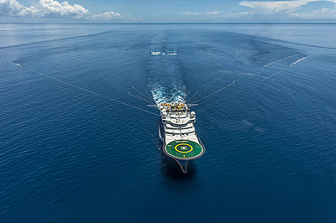
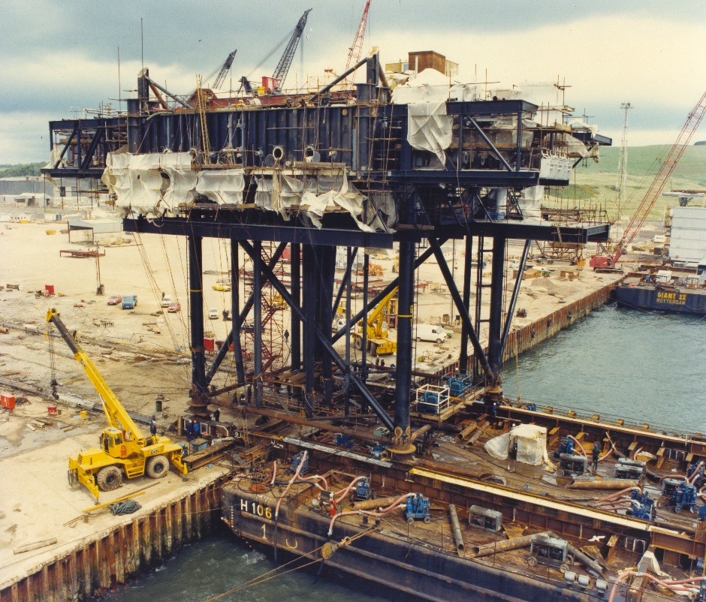
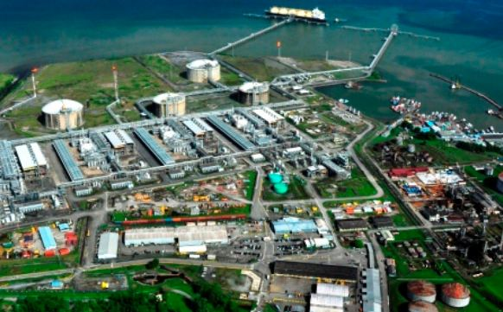
The Phases of Exploration & Production
Exploration
Seismic
Drilling
  Appraisal/Development
  Drilling
  Infrastructure construction
Production
Ongoing maintenance
Processing / Export
2 – 4 years. $1 - $10mm
  Spotters, vessel hire, accommodation,
  catering, drill crew, local transport, logistics
5 – 10 years. $500mm - $20bn
  hot trades, heavy vehicles, road construction
25 - 40 years + $100 bn+?
Wharf facilities, plant maintenance, tanker transport,
Seismic vessel
Magnus platform (BP)
Atlantic LNG Trinidad & Tobago

Slide 5
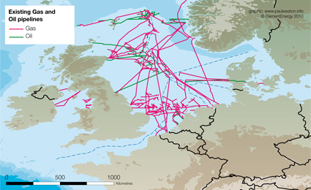
UK Oil & Gas Industry – Fast Facts
In 2013:
450,000 jobs.
Paid $13 billion royalties.
$10 billion in corporate and payroll taxes.
In 2009 the total NZ tax take from dairy, forestry and fishing was $319 million

Slide 6
UK Oil & Gas AND Fishing Industry – Fast Facts
In 2013
450,000 jobs.
Paid $13 billion royalties.
$10 billion in corporate and payroll taxes.
Add Fisheries
UK vessels landed 624,000 tonnes of sea fish (including shellfish) into the UK and abroad with a value of $1.5 billion
Around 6,400 fishing vessels were registered
Around 12,150 fishermen were reported as active in the UK. Of these, around 1,800 were part-time.
Petroleum Industry can exist with fisheries and can be a game changer if executed safely and with proper Governance

Slide 7
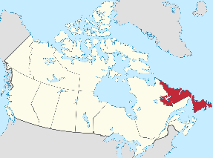
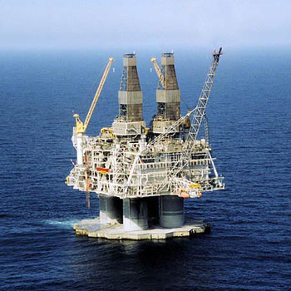
Local Benefits – Case Study Hibernia, Newfoundland, Canada
Discovered in 1980, 315 km East St John’s NFL
Required to be built locally at a greenfield fabrication yard at ‘Bull Arm’ built by Oil Companies
  600,000 ton
  Able to withstand collision with 6 million ton iceberg
  1991 – 1996
  5,800 jobs at peak
  Gifted to the state at end of construction
Bull Arm used for Terra Nova FPSO ~1998 - 2001
To be used for Hebron development ~3,500 local jobs

Slide 8
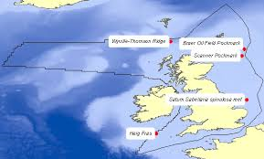
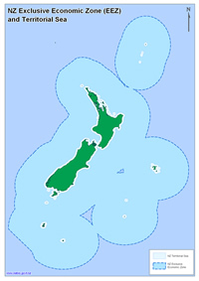
What’s the excitement about?
New Zealand’s EEZ:
  6 times larger than the UK EEZ
  4 times larger than the Norway EEZ
  4 times larger than the Canada EEZ
In Norway:
  44% less likely to be unemployed
  Earn 82.24% more
  Have 25% more free time
  46% less likely to die in infancy
UK EEZ = ~700,000 km2
NZ EEZ = ~4.3 million km2

Slide 9
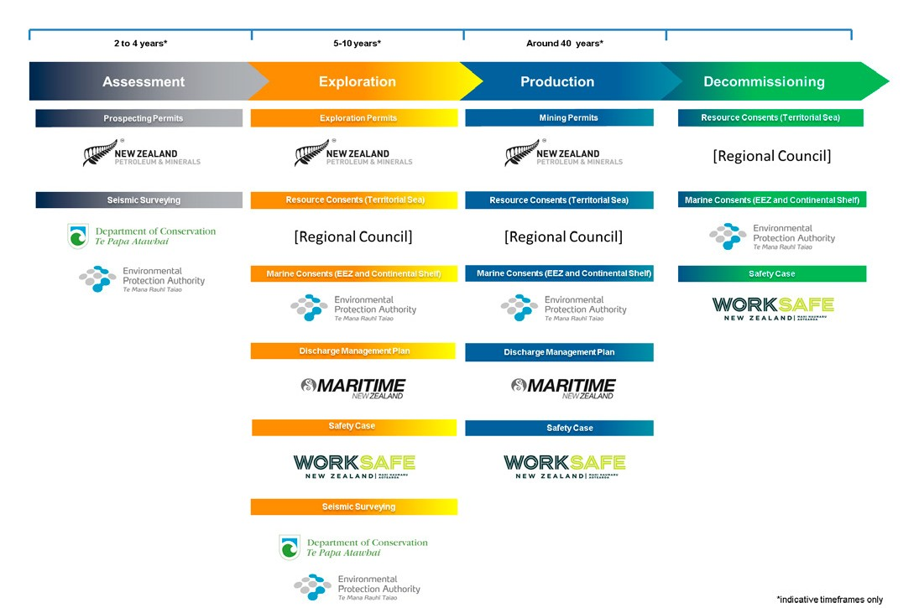
Risk Prevention: Safety to personnel is paramount. Oil workers are Dads, Girlfriends, Sons, Brothers – real people
NZ – First Rate Regulatory Regime for Drilling
In NZ (and UK) regulation of the HS & E function is undertaken by a different regulator to the permitting body (NZ Petroleum & Minerals)
This division did not exist in the Gulf of Mexico and is a key reform recommended by the International Bar Association* and implemented by Obama
EPA: Independent panel of experts. Awards a marine consent provided Operators submit an environmental impact assessment that identifies the effect of drilling on the environment and measures to avoid, mitigate or remedy adverse effects
Maritime NZ: Approve a discharge management plan that demonstrates how risks of spills/blowouts have been minimised
Worksafe NZ: Approve the safety case that demonstrates that the drilling rig is safe. Hazards must be identified and control measures implemented
Industry
New standards for blow out preventer maintenance and well completions:
  API Std 53 Practices for Blowout Prevention Equipment Systems for Drilling Wells
  API RP 96 Deepwater Well Design Considerations
  API Bulletin 97 Well Construction Interface Document
  API RP 65-2 Cementing & Isolation & Barriers
* Sean Rush was a member of the IBA working group that reviewed the GoM regulatory regime and provided submissions to the EU on regulatory improvements.

Slide 10
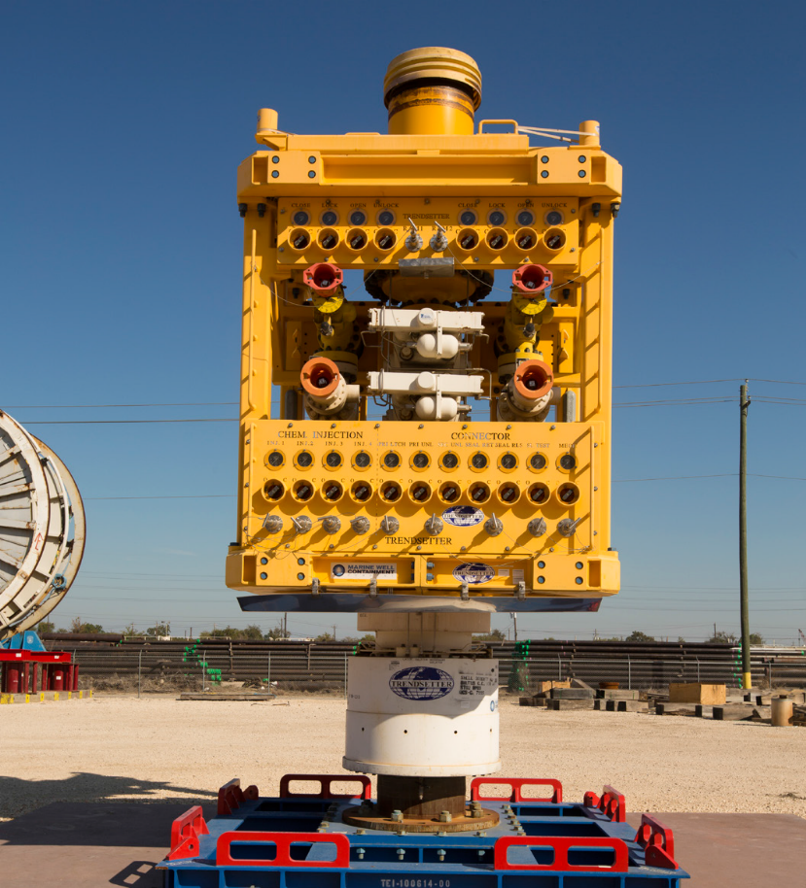
Responding to Spills
Government
Maritime NZ has detailed and up to date Oil Spill Response plans
Able to call upon international capability
  Oil Spill Response Limited - a global response capability incl. capping devices designed for deep-water
  Australian Marine Oil Spill Centre – centre for Australian spill response capability
All costs payable by the oil company
Industry
New standards
Built and tested 4 capping devices that are located globally and available
Consortium (incl. Chevron and Statoil) invested US$1 billion in research and development for GoM alone
Capping Stack

Slide 11
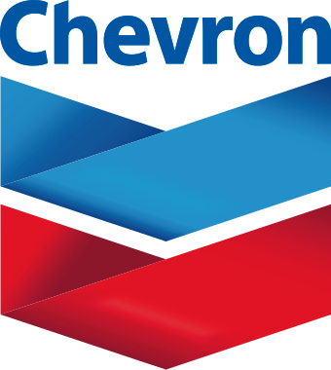
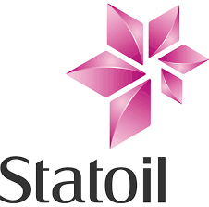

  How do 21st Century Oil Companies Think?
  ‘doing good is good business’
  Social and other media is very important for reputation
Corporate value measured by share price – 1p/BP share = ~NZ$365 million
  New Breed of ‘ethical’ investors mean that share value is influenced by Business ethics
  ‘Corporate Social Responsibility’ teams have significant budgets to spend
  Community projects
  Ethical operations
  Doing the ‘right’ thing even if not required by local Government
  The market demands that Oil Companies ‘Care’
Oil People Care
US$275 mm invested in social responsibility projects in 2013
US$40 mm invested in social responsibility projects in 2013
US$159 mm invested in social responsibility projects in 2013

Slide 12
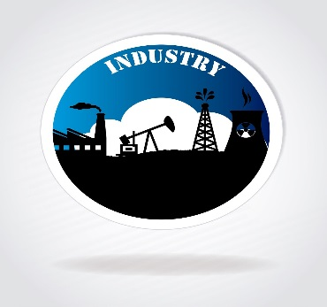

  Why would an Oil company engage with Iwi?
Iwi can be a powerful partner for Oil companies to advance their operations safely
  Partnership with Iwi would be a significant step for an Oil company’s Corporate Social Responsibility team
It’s simply good business
  Iwi provide a robust sounding board for environmental management
  Iwi provide in country knowledge and deep understanding of the operating environments
  Iwi are commercially astute and can contribute to business decisions that have local implications
  Building long term local relationships is vital to support a sustainable NZ business

Slide 13
Why would Iwi engage with an Oil Company?
Protection of rohe – Iwi are the only ones who can advise on their rohe
Oil Companies (like Sealord) are free to deliver economic and other benefits that are not open to Government
  Oil companies will always be needed regardless of whether the Crown or Iwi own the resource
  free to allocate their share of revenues
  can agree employment, sponsorship and knowledge share
  may partner under a JV
Iwi collaboration with Oil Companies may deliver benefits similar to those claimed under the Treaty faster and be more fit for purpose

Slide 14

Next?
Until exploration/appraisal are complete the risks and benefits of a petroleum industry will not be fully known. This will take several years, maybe decades
Meantime, be vigilant and keep an open mind:
  If the risks prove too high then be sufficiently informed to advocate for a halt
  If benefits become apparent then be ready to take advantage
E seanrush@spindletop.co.nz
P 027 706 7360
www.spindletop.co.nz
Questions?

